Slide 1
INTRODUCTION
Computer-Memory plays an important role in storing information
Further classified into two types
Volatile memory
Non – volatile memory
It contains some fuses that can be performed for a piece of specific information
ROM – Information are stored in binary format

Slide 2
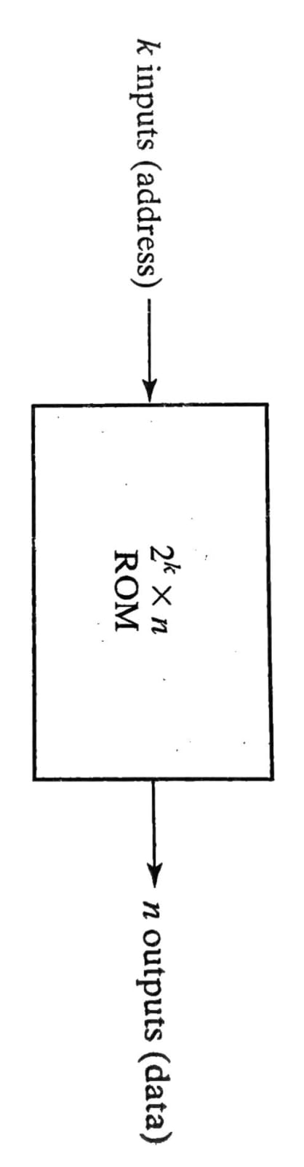
READ – ONLY MEMORY
A block diagram of a ROM is shown below. It consists of k address inputs and n data outputs.
The no. of words in a ROM is determined from the fact that k address input lines are needed to specify 2 words.
k
k- input lines
N- output lines
Whereas, each line consist of n bit of information
ROM BLOCK DIAGRAM

Slide 3
CONSTRUCTION OF ROM
Each output of the decoder represents a memory address.
Each OR gate must be considered as having 32 inputs.
A 2 x n ROM will have an internal k x 2 decoder and n OR gates.
k
k
DEVICE | AND – ARRAY | OR – ARRAY
PROM | FIXED | PROGRAMMABLE

Slide 4
TYPE OF ROM
MROM - MASKED READ ONLY MEMORY
PROM - PROGRAMMABLE READ ONLY MEMORY
EPROM – ERASABLE PROGRAMMABLE READ ONLY MEMORY
EEPROM – ELECTRICALLY ERASABLE PROGRAMMABLE READ ONLY MEMORY

Slide 5
FEATURES OF ROM
ROM is a non volatile memory
Information stored in ROM is permanent
Information and programs stored on it , we can only read and cant modify
Information and programs are stored on ROM in binary format
It is used in the start up process of the computer

Slide 6
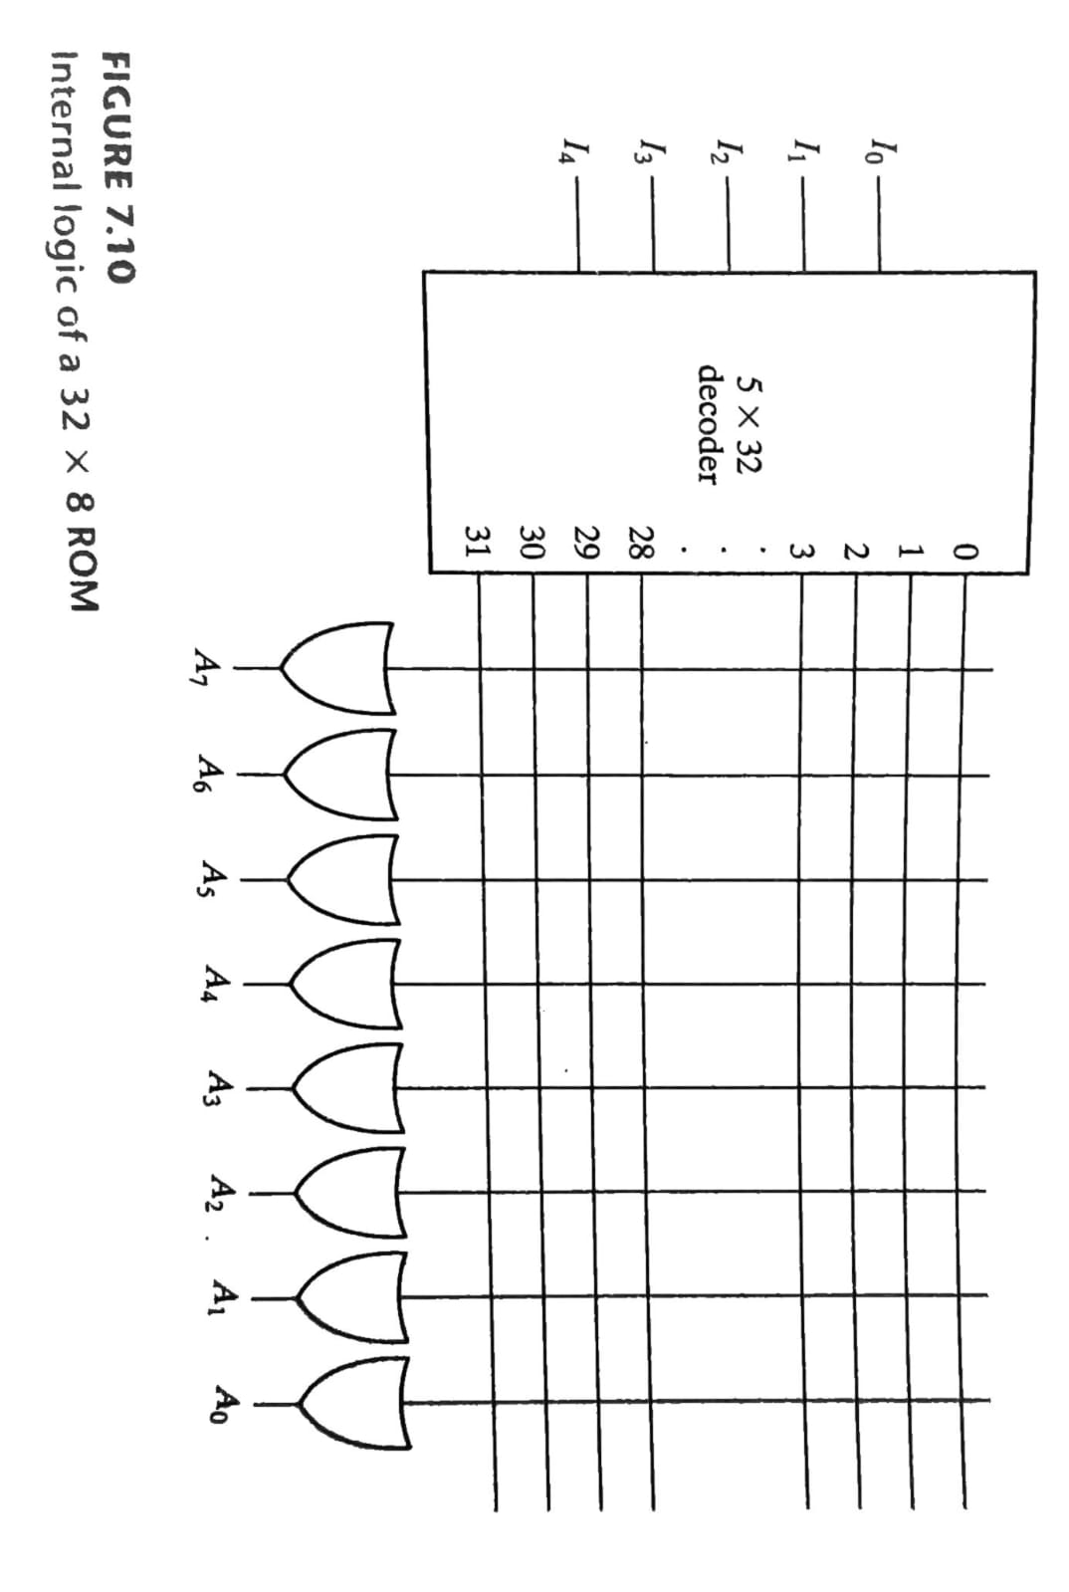
CONSTRUCTION OF ROM

Slide 7
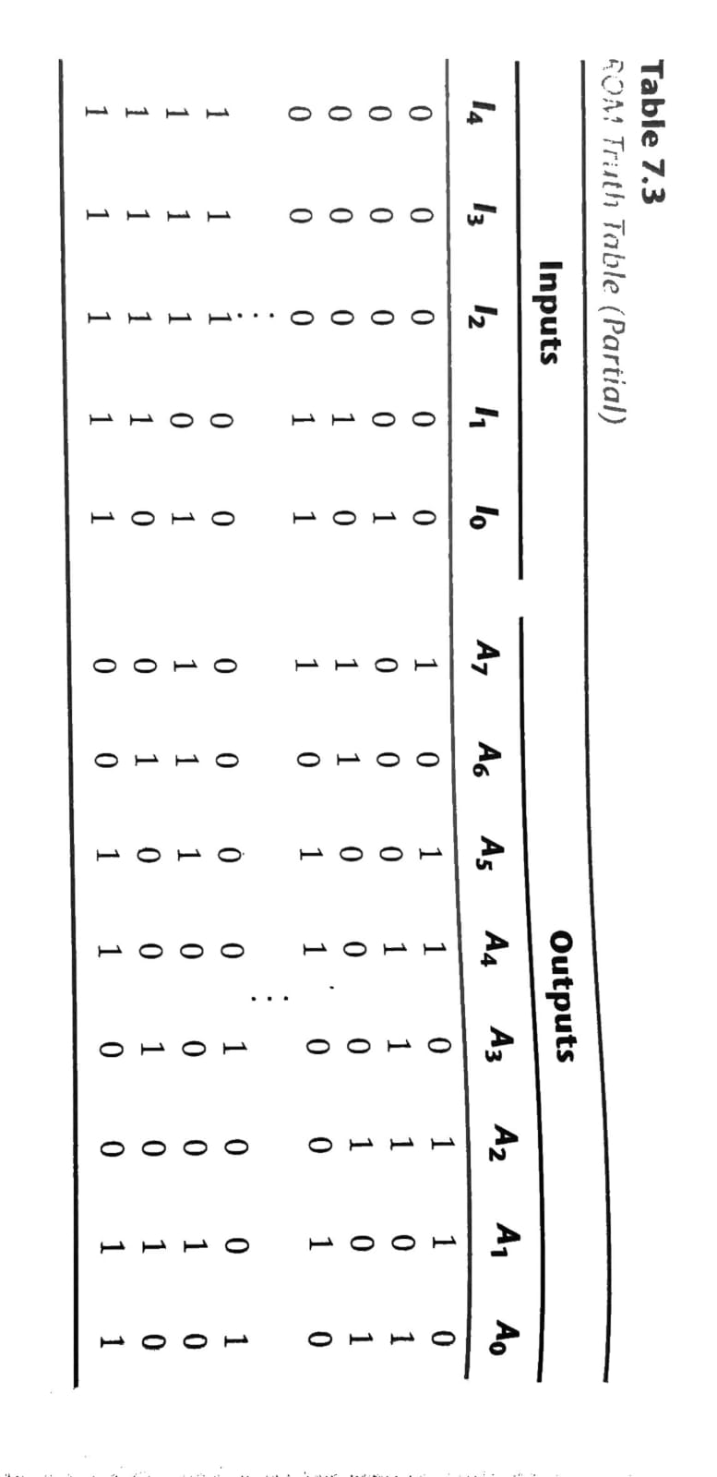
TRUTH TABLE OF ROM
A programmable connection between to lines is logically equivalent to a switch that can be altered to either be close or open.
Intersection between two lines is sometimes called a cross-point

Slide 8
PROGRAMMING THE ROM
In the table shown before, 0 no connection
1 connection
Address 3 = 10110010 is permanent storage using fuse link.
In the diagram, X means connection

Slide 9
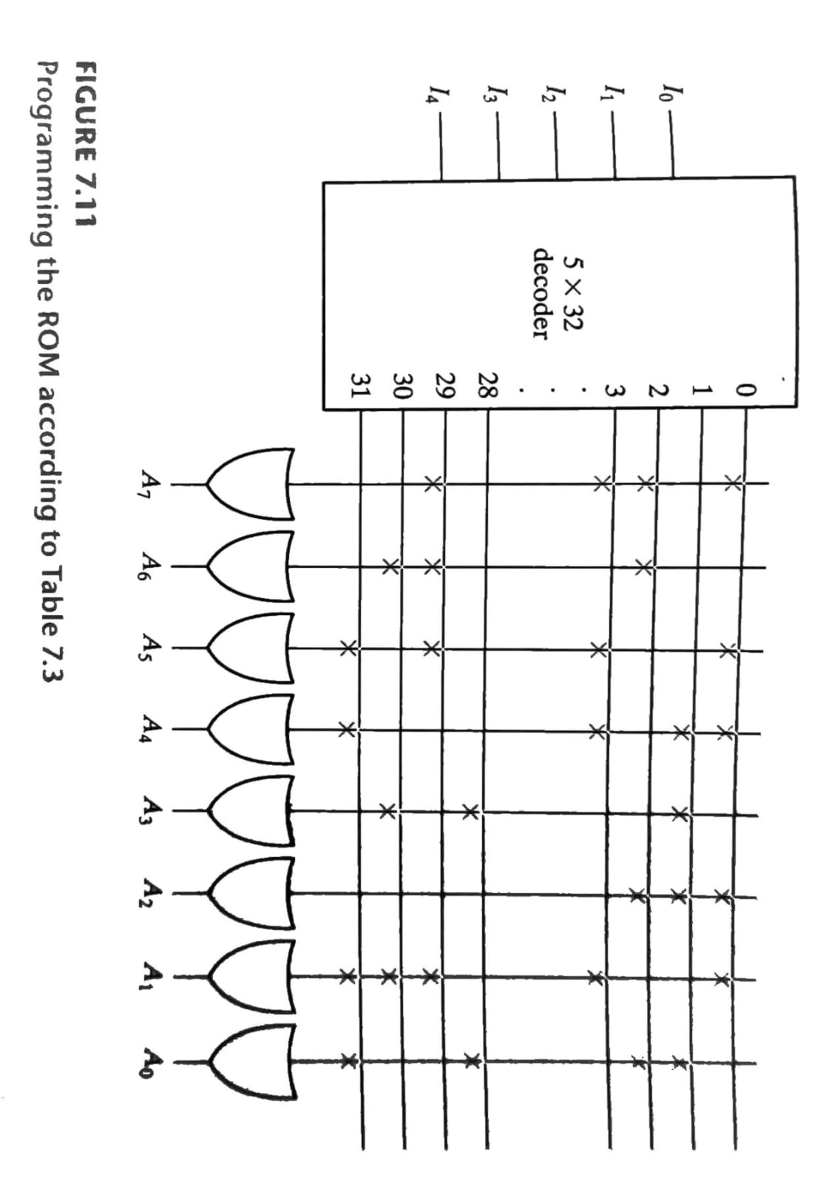
PROGRAMMING THE ROM

Slide 10
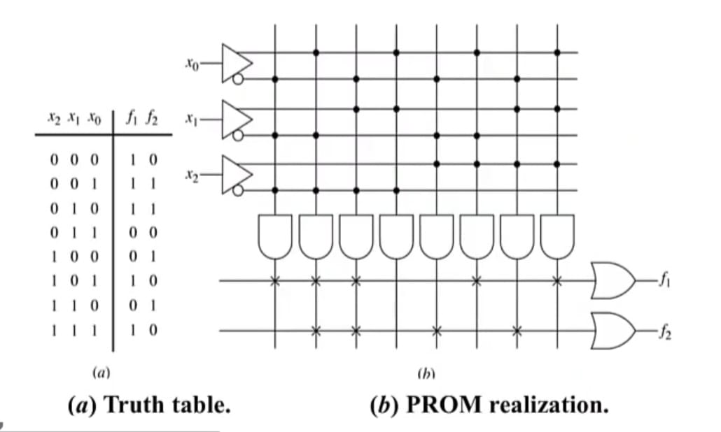
USING A PROM FOR LOGIC DESIGN
EXAMPLE :

Slide 11
USING A PROM FOR LOGIC DESIGN

Slide 12
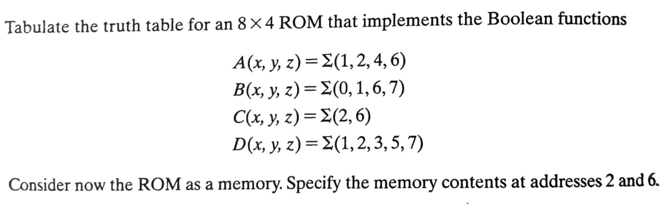
EXAMPLE 2 :

Slide 13
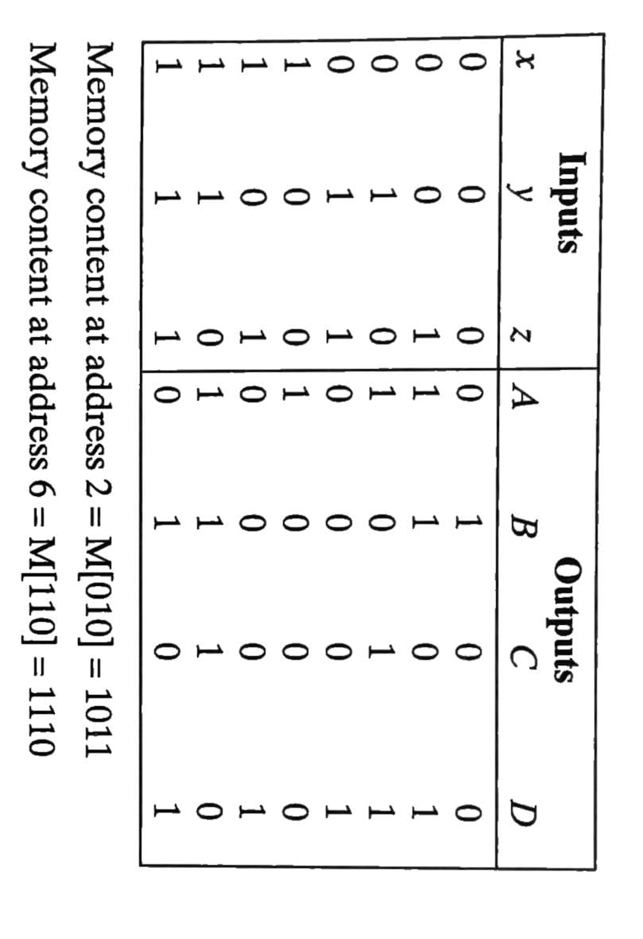
SOLUTION :

